Slide 1
Large Language Models
Jian Tang
HEC Montreal
Mila-Quebec AI Institute
Email: jian.tang@hec.ca
Some of the slides are borrowed from: https://phontron.com/class/anlp-fall2024/

Slide 2
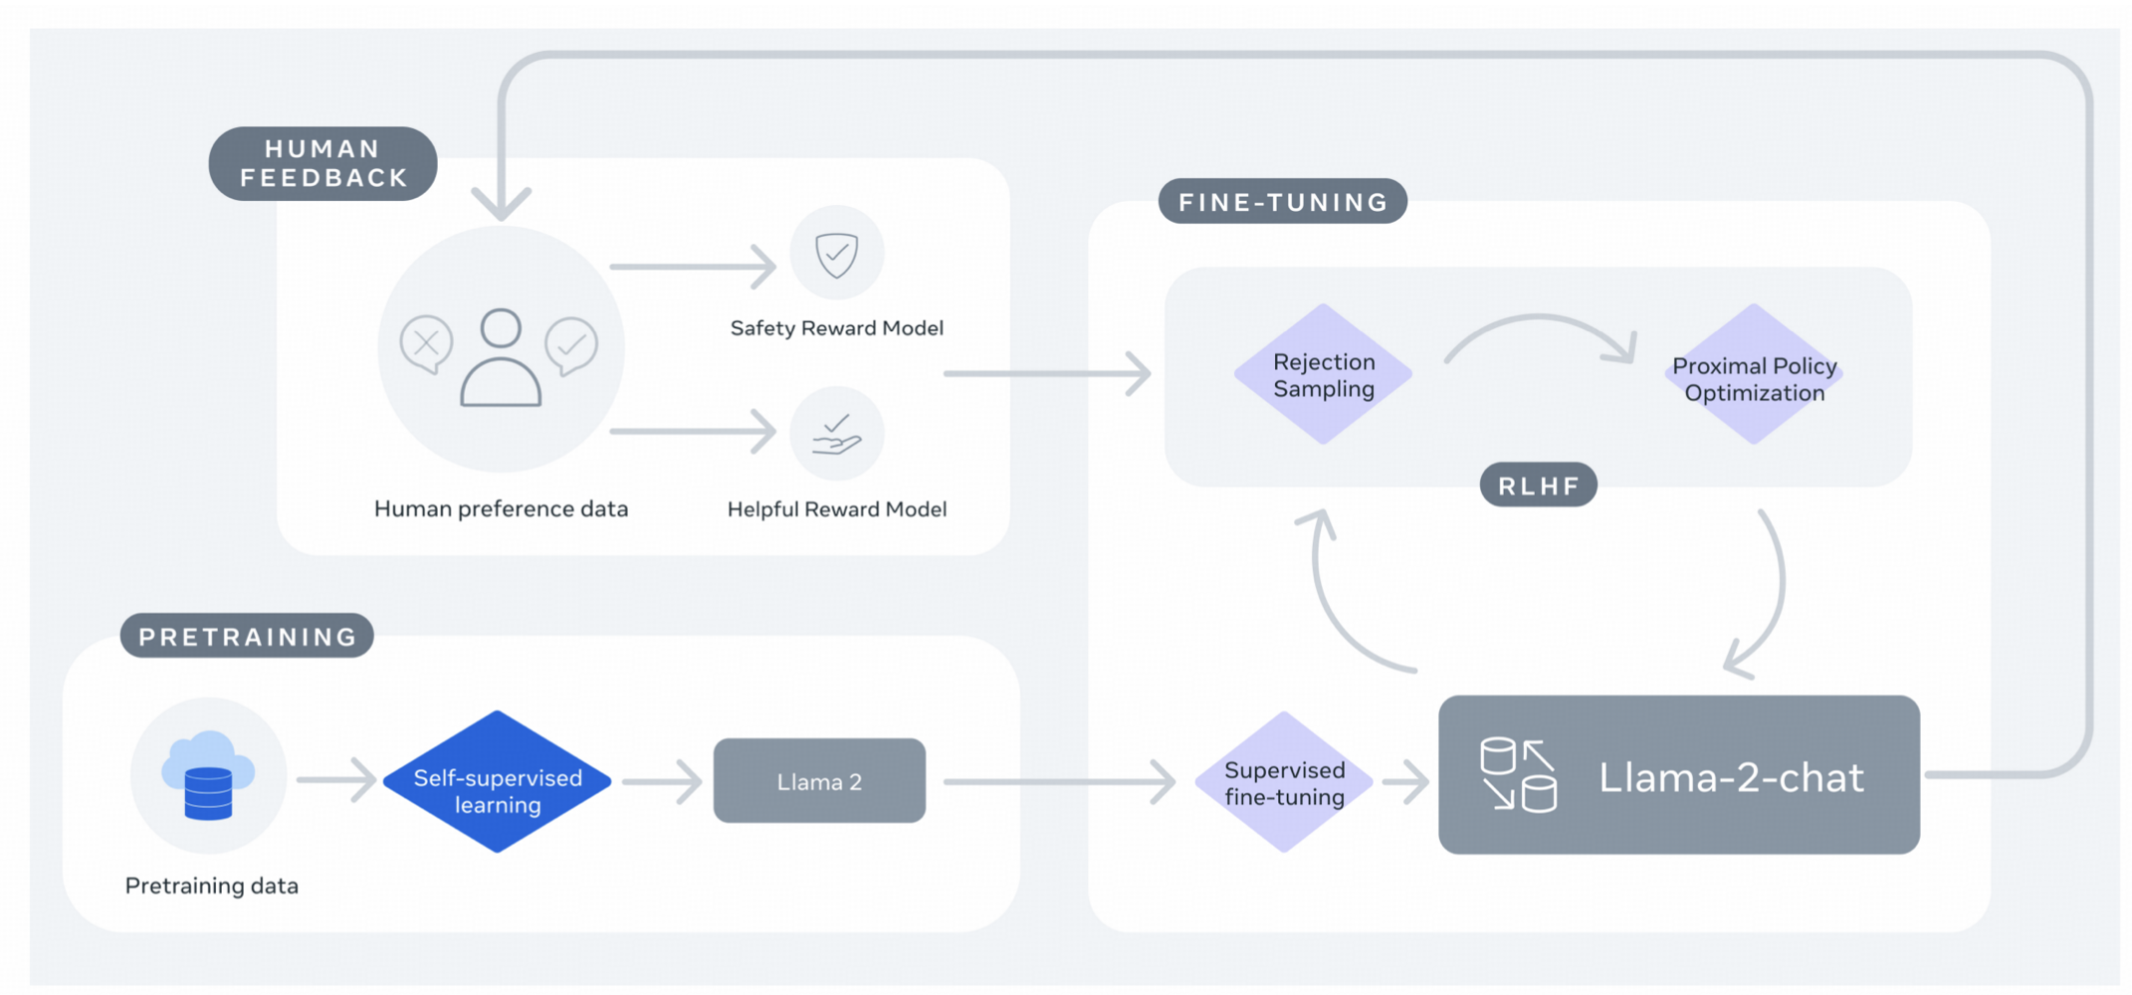
Overview of LLMs Training
Pretraining -> Supervised Fine-tuning (SFT) -> Reinforcement Learning Human Feedback (RLHF)

Slide 3
Outline
Fine-tuning
Instruction Tuning
Prompting

Slide 4
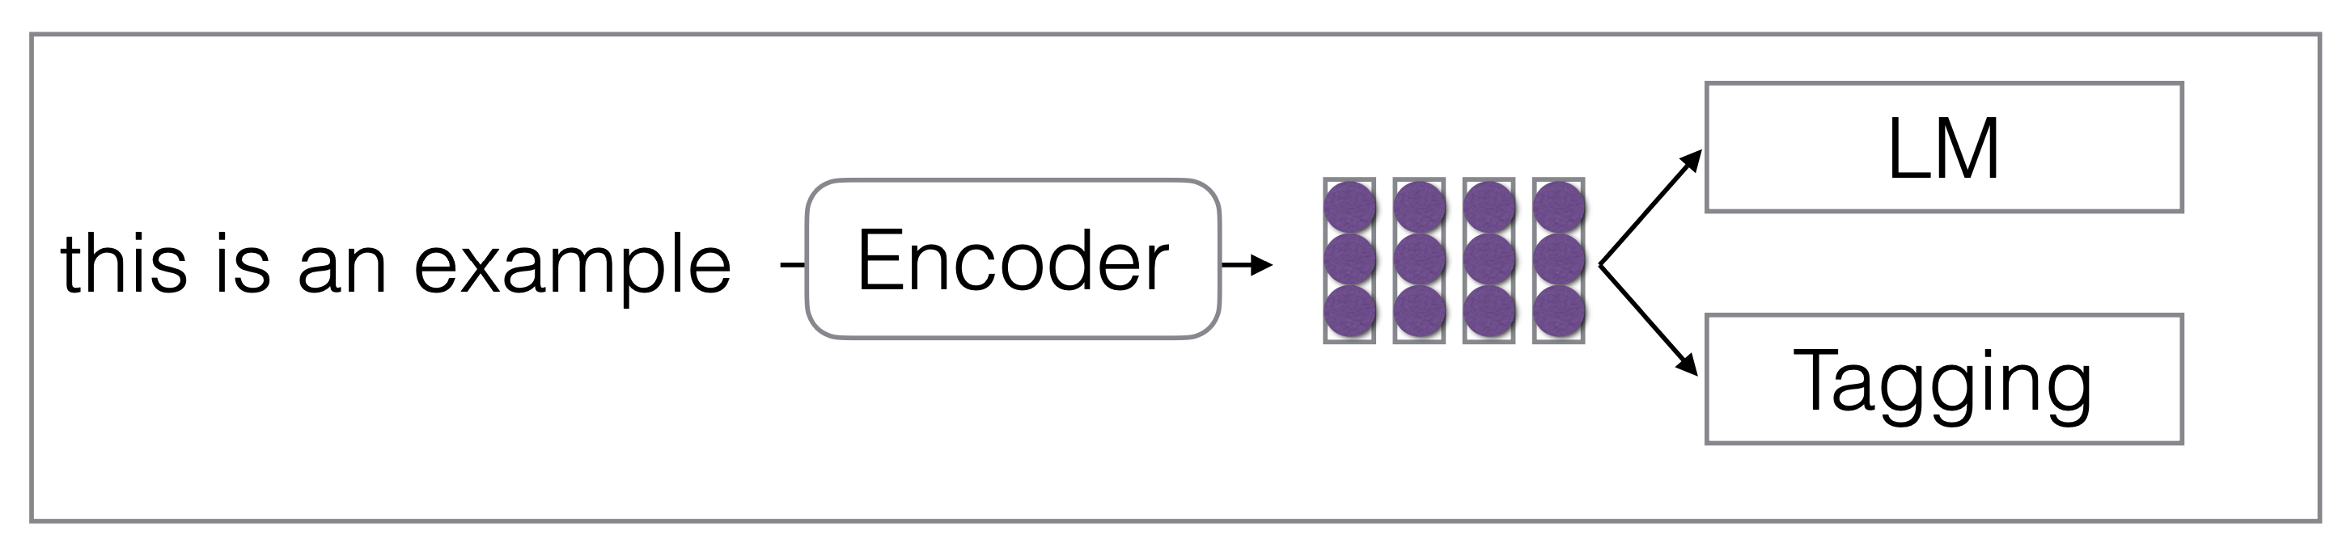
Standard Multi-task Learning
Train a neural network for multiple different tasks

Slide 5
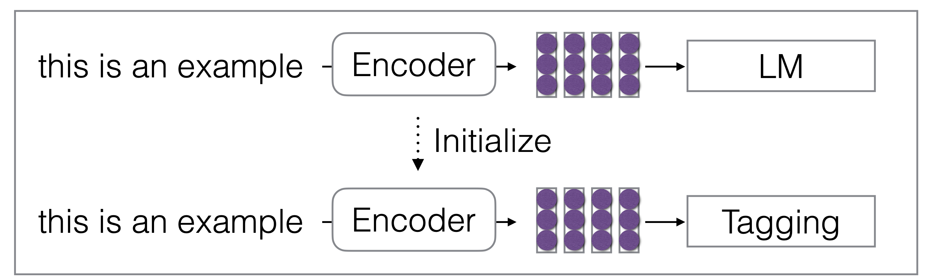
Pre-train and Fine-tune Framework
Pre-train a model on a set of tasks and then fine-tune it on new tasks
E.g. Pretrain a LLM and then fine-tune it with a classification task

Slide 6
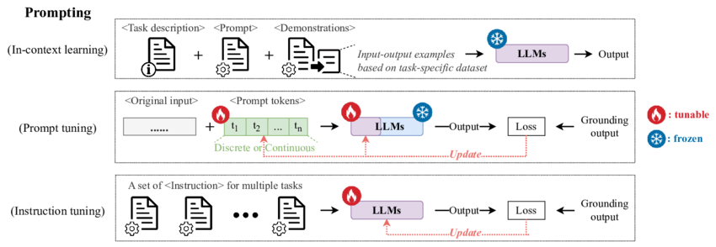
Prompting
Fix the parameters of LLM, change the instructions
Some task-specific labeled examples can be inserted into the prompts

Slide 7
Instruction Tuning
Fine-tuning LLMs with many different tasks, with instructions specifying each task
The parameters of LLMs will be updated

Slide 8
Outline
Fine-tuning
Instruction Tuning
Prompting

Slide 9
Different NLP Downstream Tasks

Slide 10
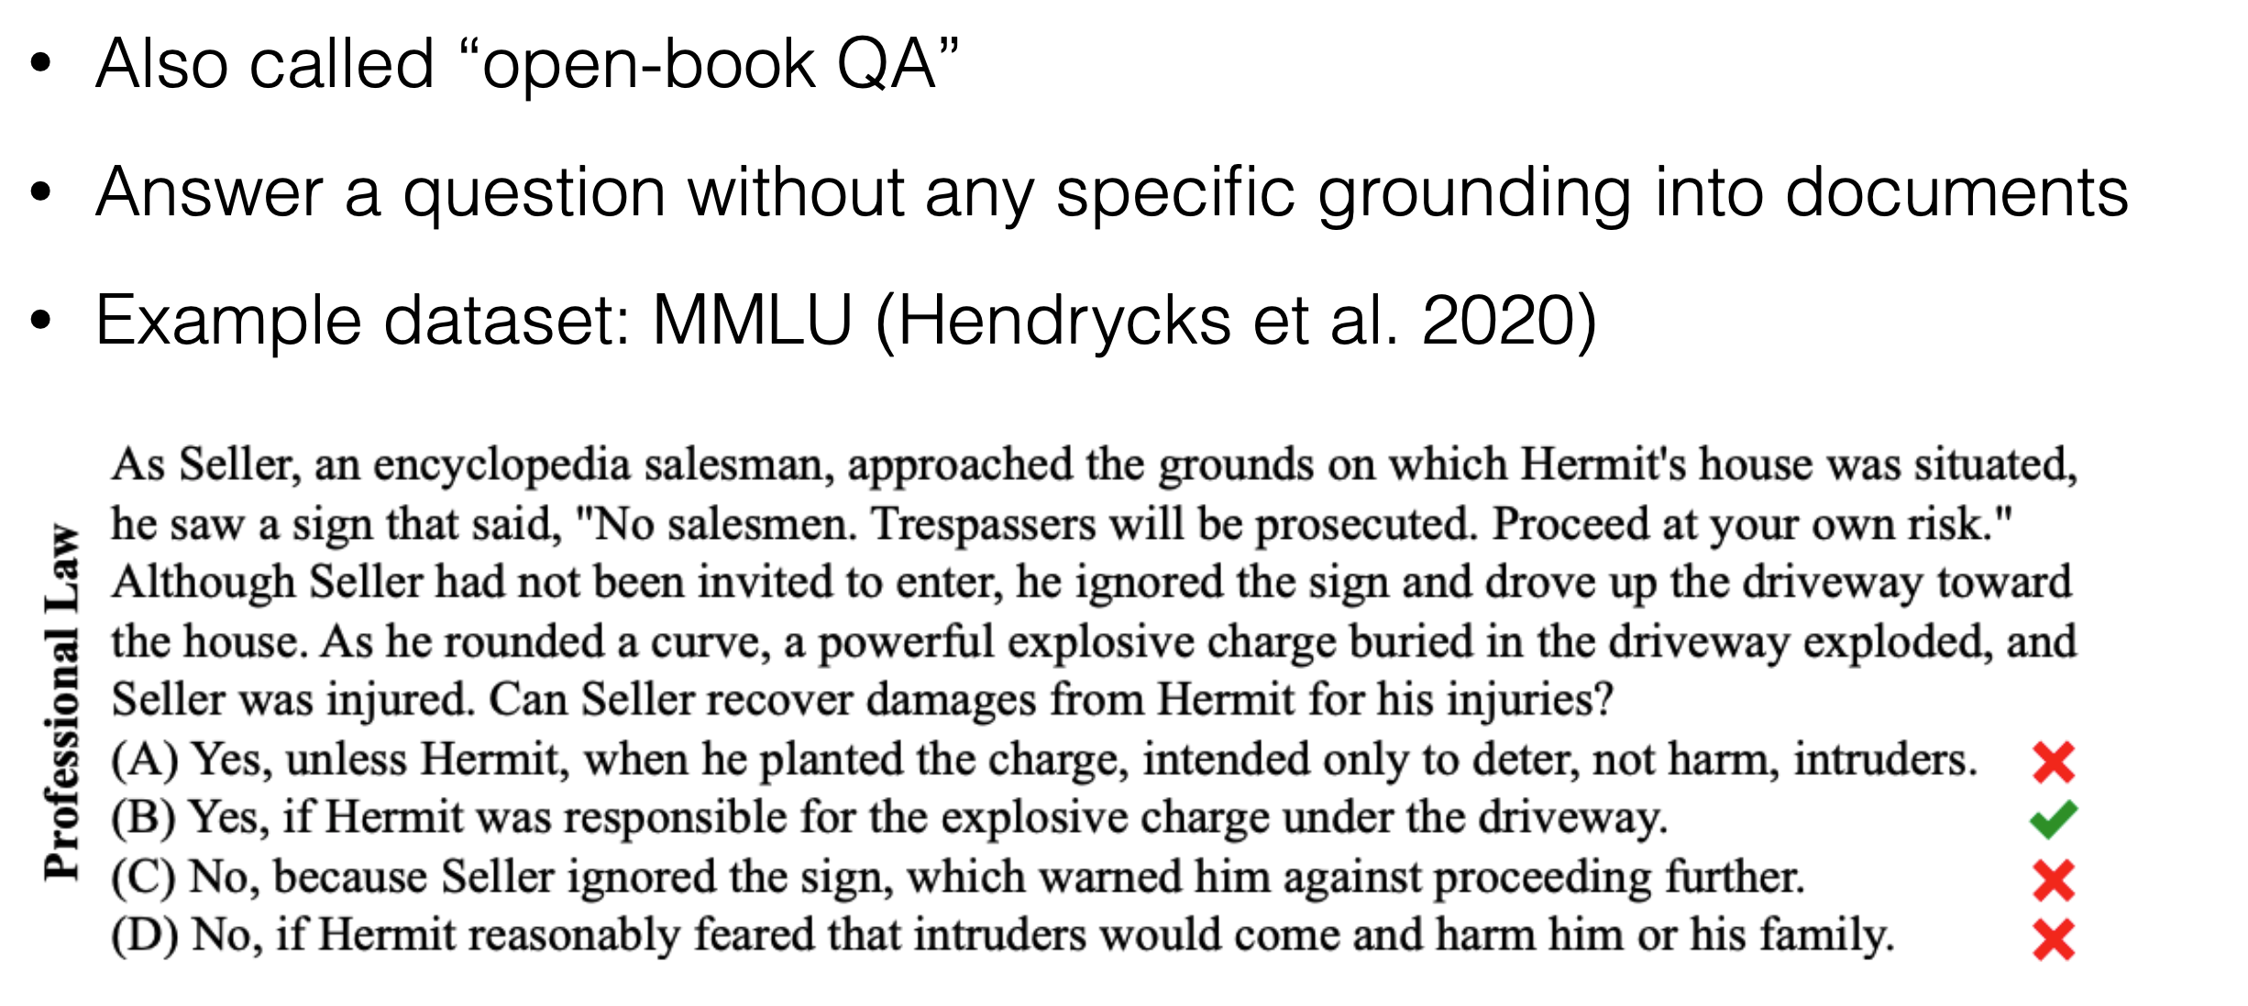
Context-Free Question Answering ()

Slide 11
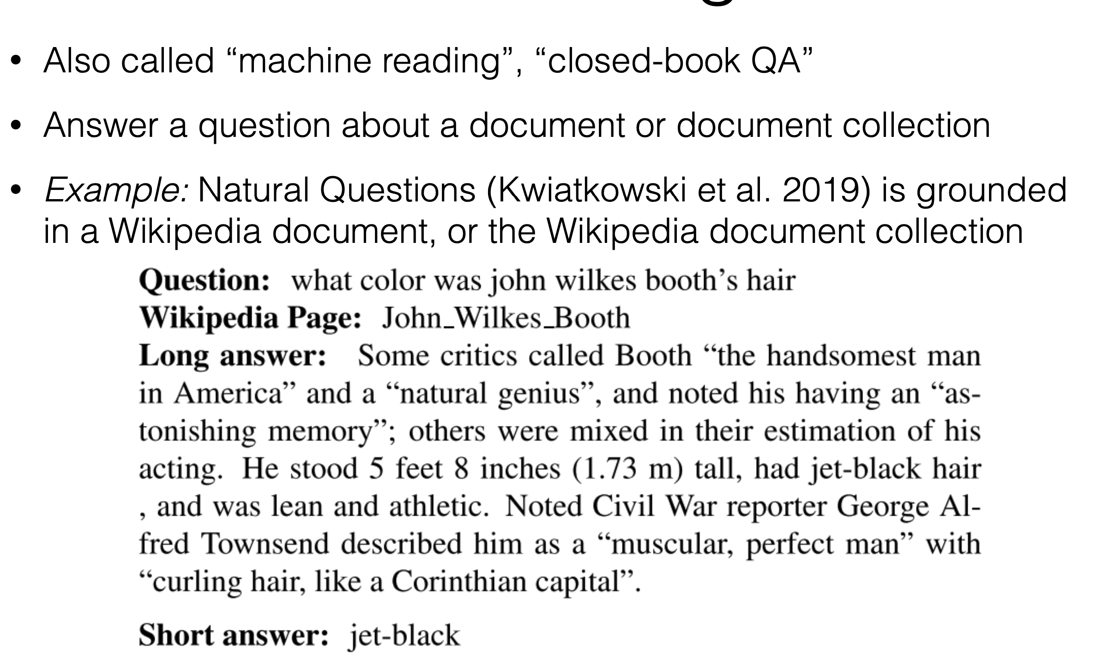
Contextual Question Answering

Slide 12
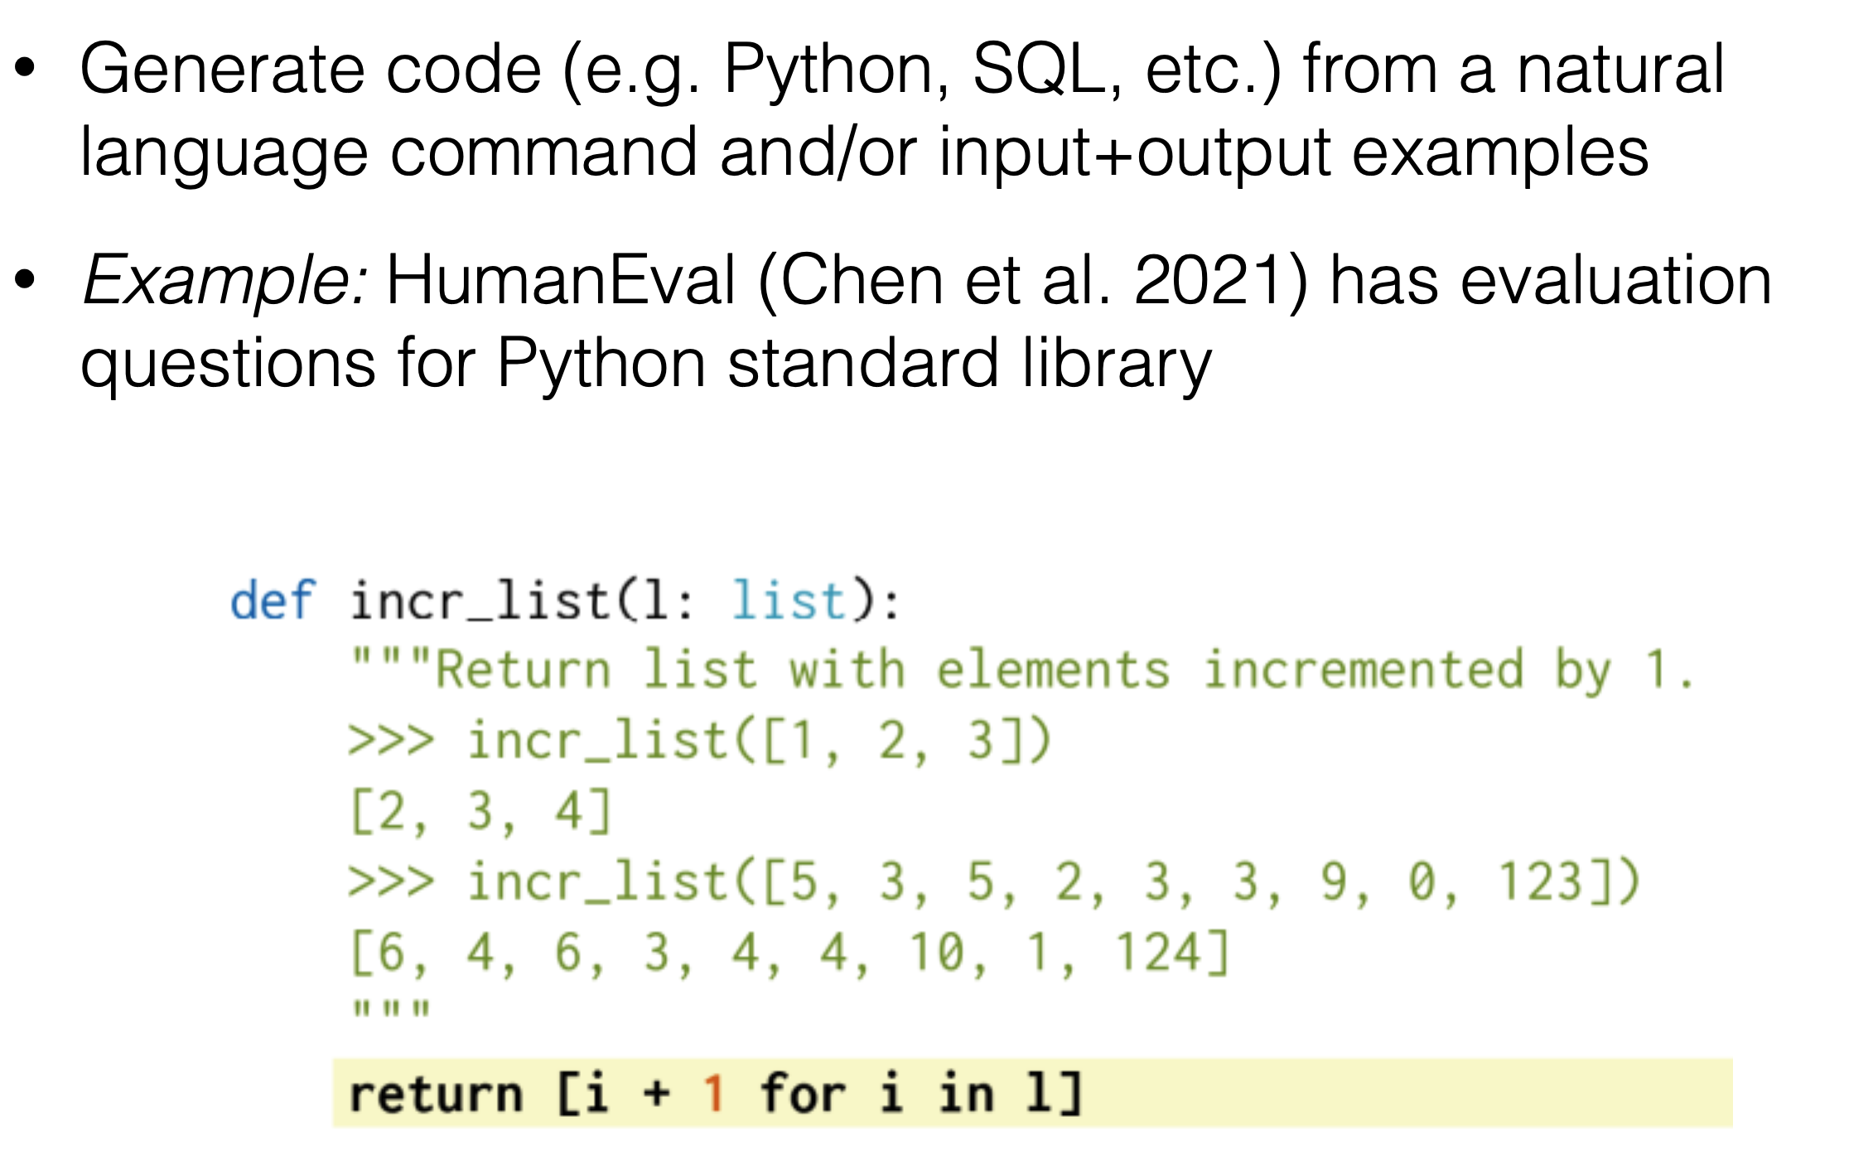
Code Generation

Slide 13
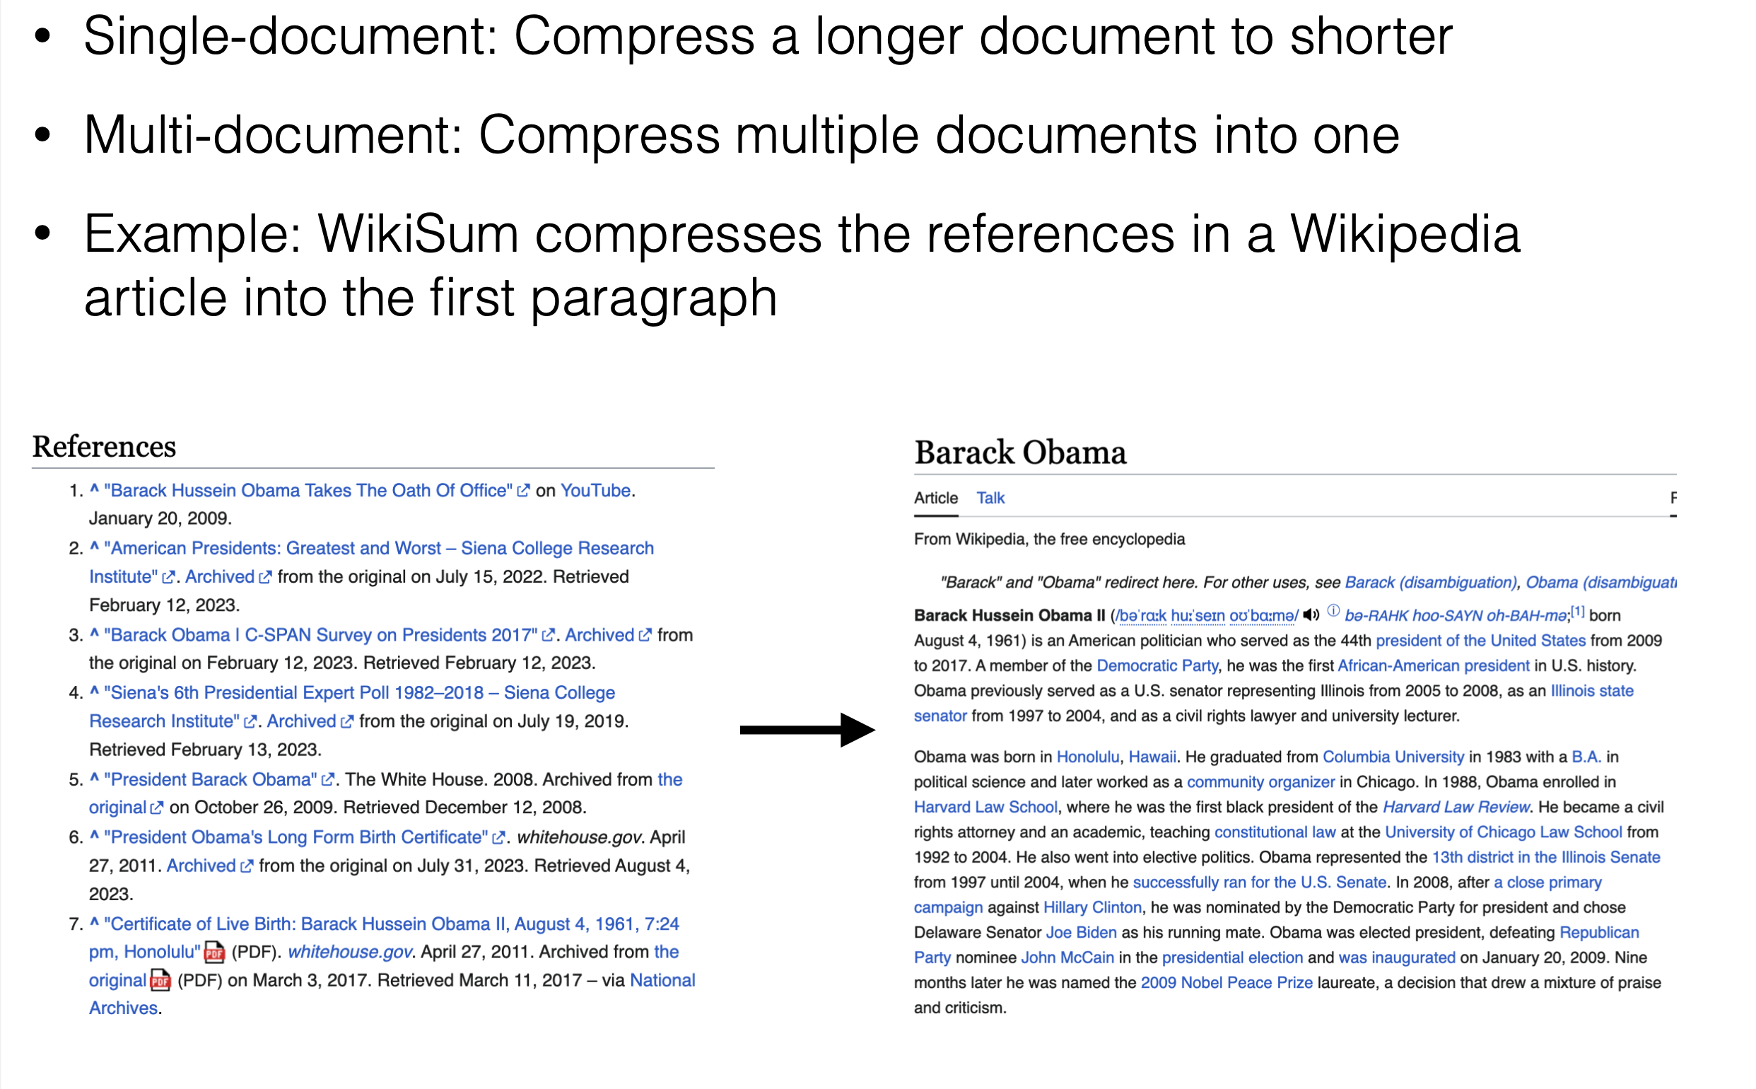
Text Summarization

Slide 14
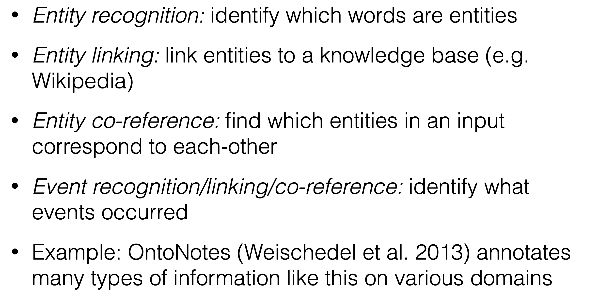
Information Extraction

Slide 15
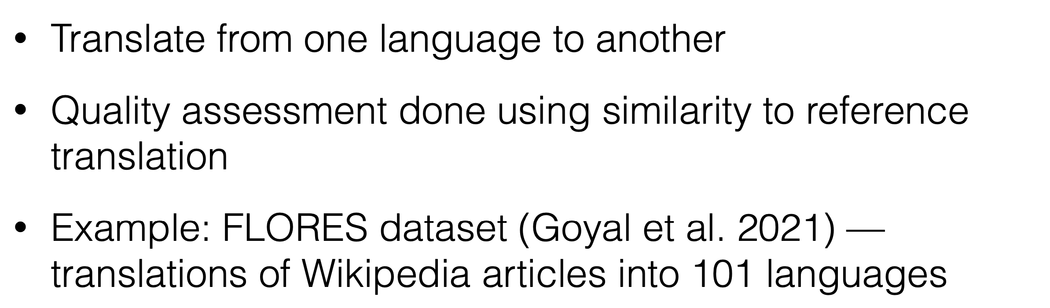
Machine Translation

Slide 16
Mismatch between LLM Pretraining and Downstream Applications
LLMs are pretrained on the task of next token prediction
Downstream applications: perform specific tasks
E.g., sentiment classification
Question answering
Summarization
Machine translation

Slide 17
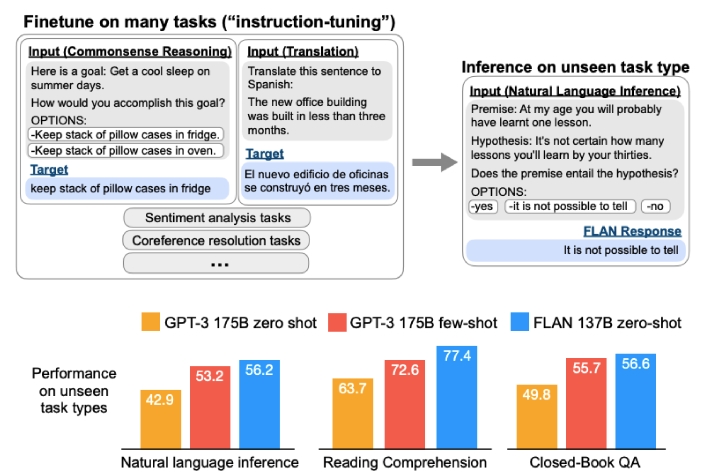
Instruction Tuning
Pre-train an LLM, then fine-tune it on many different tasks, and generalize to new tasks

Slide 18
Instruction Tuning
Finetuning LLMs using (INSTRUCTION, OUTPUT) pairs
INSTRUCTION: human instruction for the model
OUTPUT: the desired output that follows the INSTRUCTION
Objectives:
Bridge the gap between pretraining objectives and downstream applications
Steer the model behavior towards more controllable and predictable
Quickly adapt to a new domain without extensive retraining

Slide 19
Instruction Dataset Construction
Each instance is composed of three elements:
An instruction: a natural language text sequence to specify the task
An optional input: supplementary information for context
Output: an anticipated output based on the instruction and the input

Slide 20
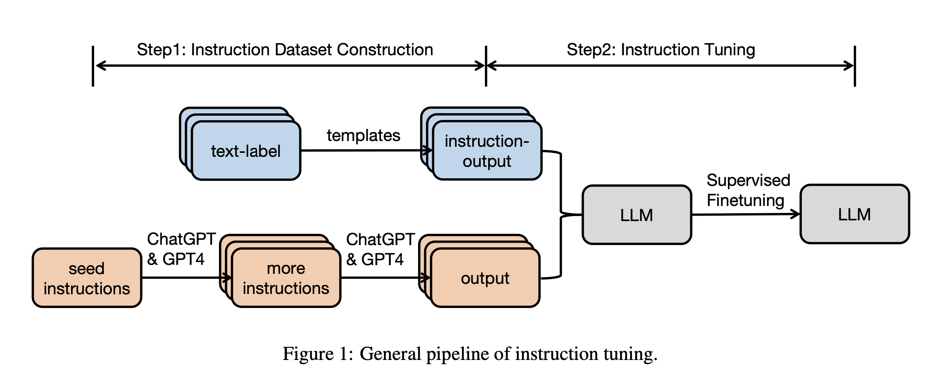
Instruction Dataset Construction
Two approaches
Data integration from annotated natural language datasets
Generating outputs from LLMs

Slide 21
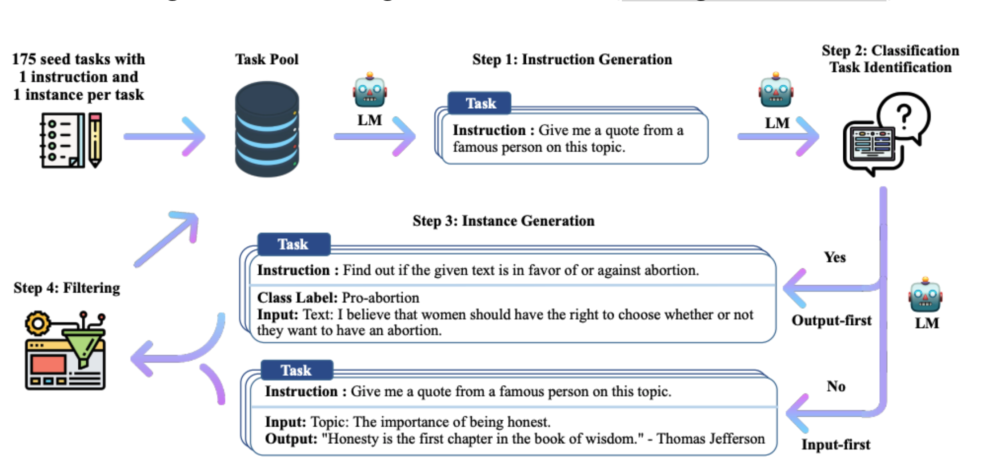
Automatically generating instruction tuning data from LLMs (Self-Instruct, Want et al. 2022)
https://arxiv.org/abs/2212.10560

Slide 22
Outline
Fine-tuning
Instruction Tuning
Prompting

Slide 23
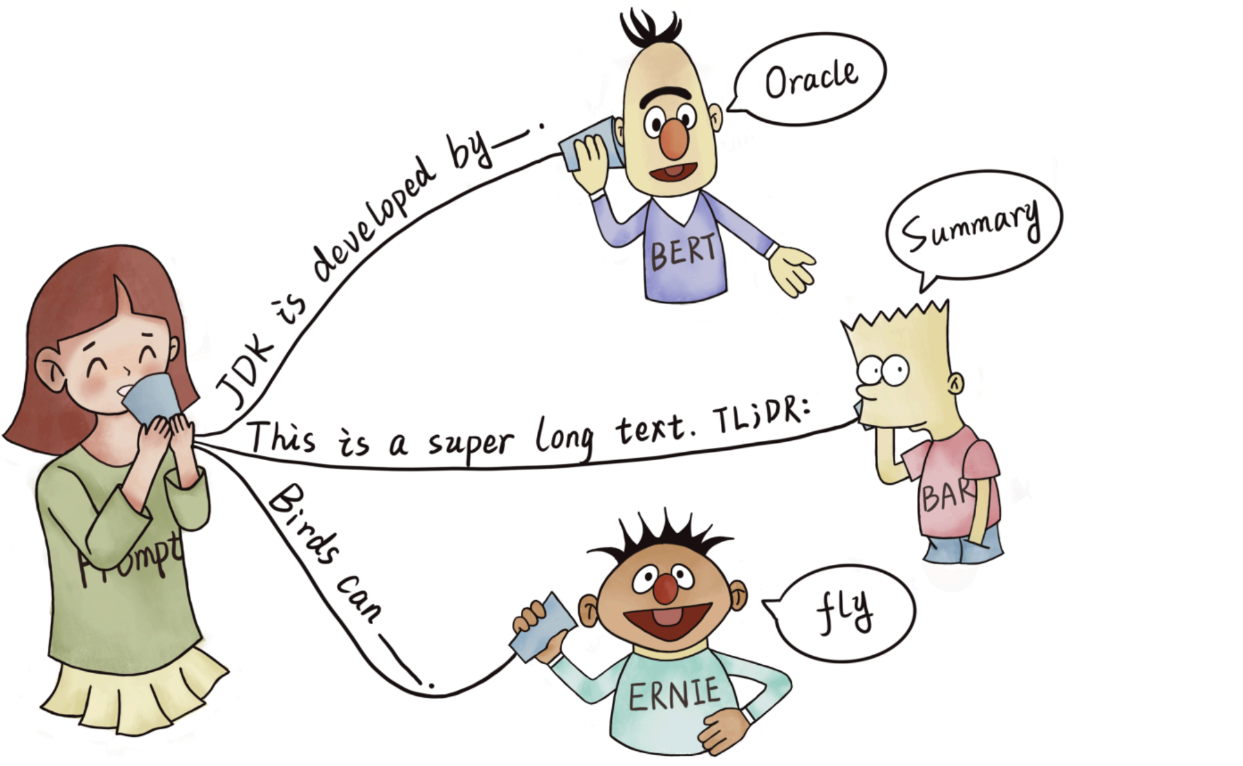
What is Prompting?
Encouraging a pre-trained model to make particular predictions by providing a textual “prompt" specifying the task to be done
providing LLMs with more context and information
With prompts, the model can better understand what kind of output is expected and produce more accurate and relevant results.

Slide 24
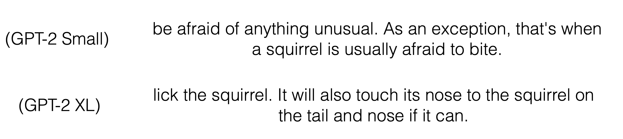
Basic Prompting (Radford et al. 2018)
Append a textual string to the beginning of the sequence and complete
x = When a dog sees a squirrel, it will usually

Slide 25
Standard Prompting Workflow
Fill a prompt template
Predict the answer
Post-process the answer

Slide 26
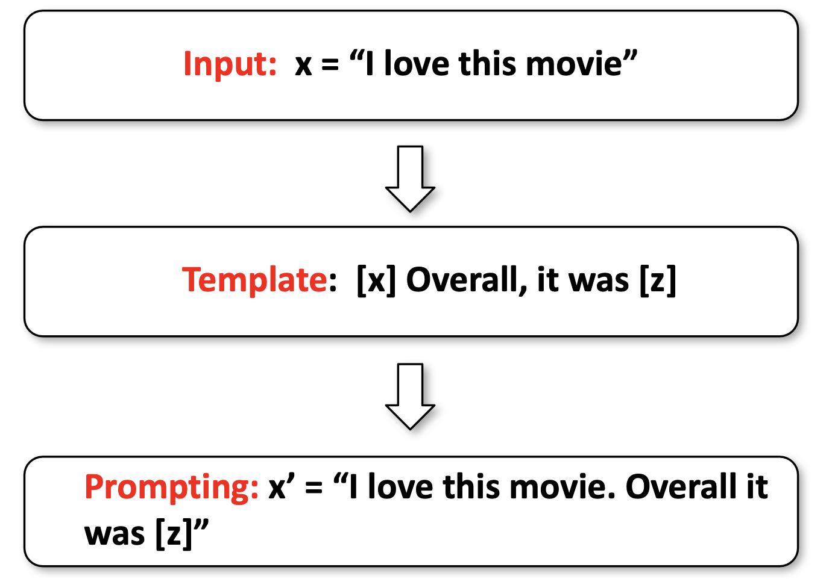
Prompt Templates
A template where you fill in with an actual input

Slide 27
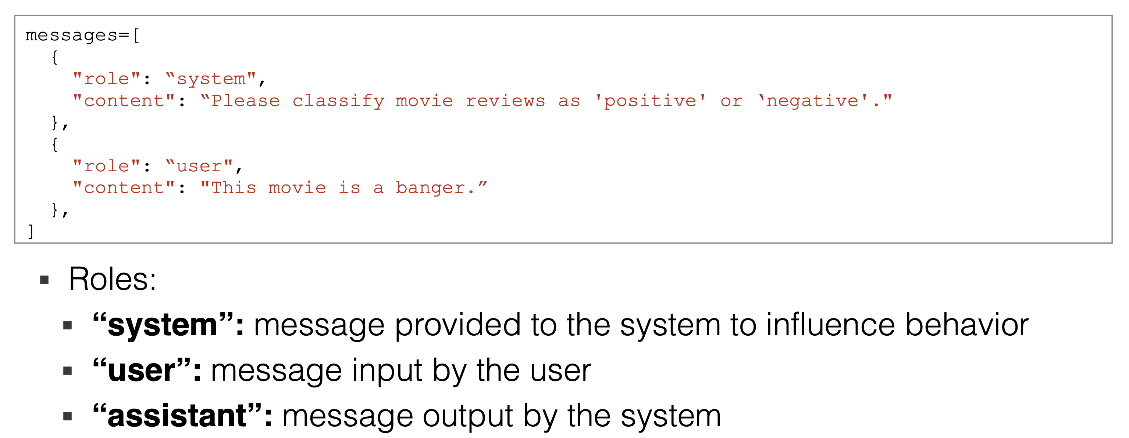
Chat Prompts
Recently, many models are trained as chatbots
Usually inputs are specified in OpenAI messages format

Slide 28
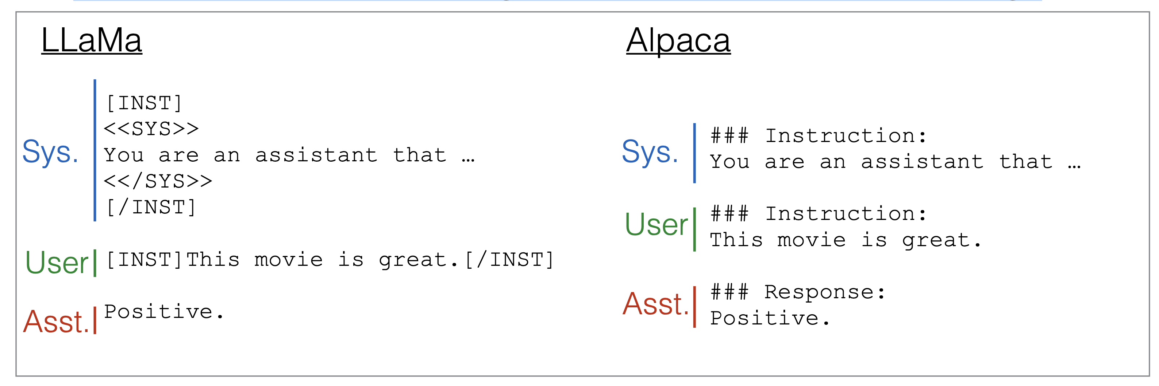
Chat Prompts Behind the Scenes
Behind the scenes, messages are converted to token strings

Slide 29
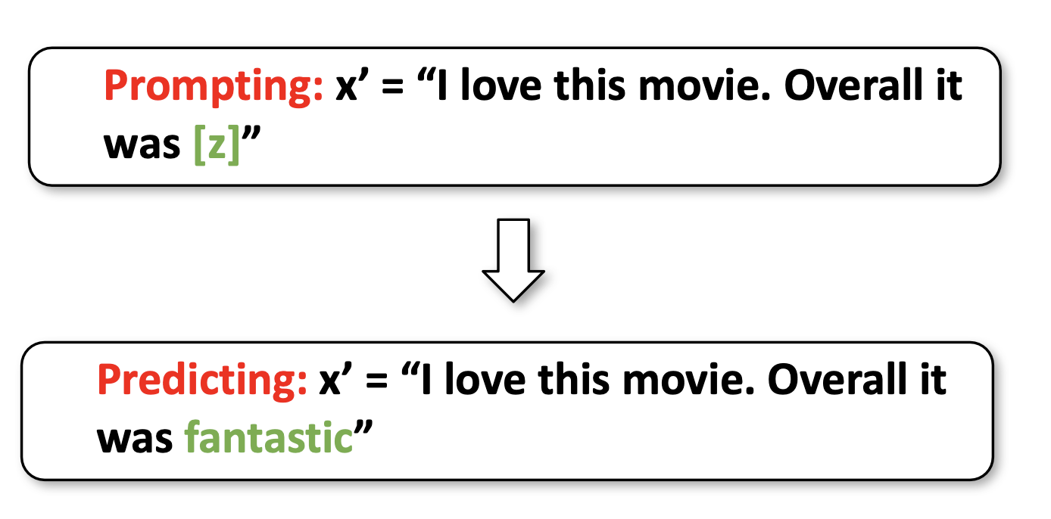
Answer Prediction
Given a prompt, predict the answer
Use any inference algorithms, as in generation class

Slide 30
Post-processing
Based on the answer, select the actual output
For instance:
Taking the output as-is
Formatting the output for easy visualization
Selecting only parts of the output that you want to use
Mapping the outputs to other actions

Slide 31
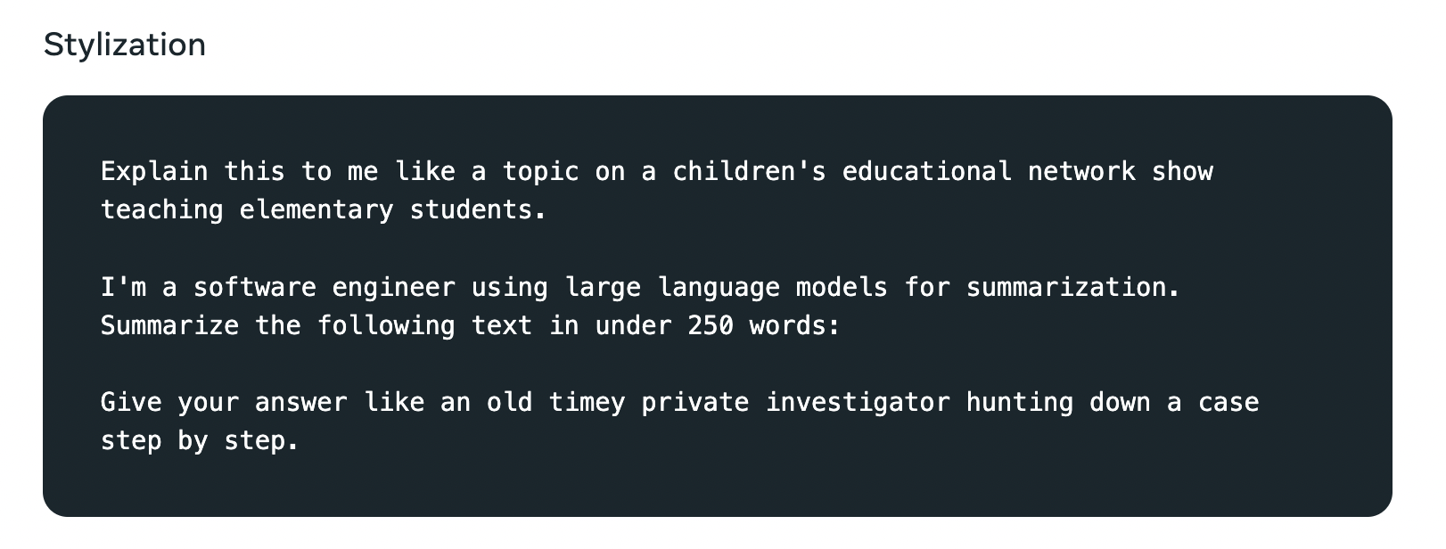
Explicit Instructions

Slide 32
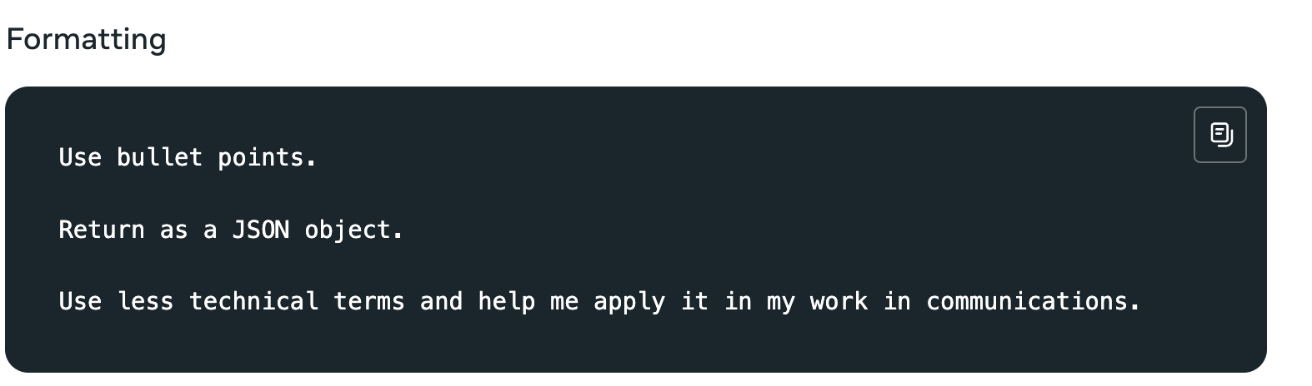
Explicit Instructions

Slide 33
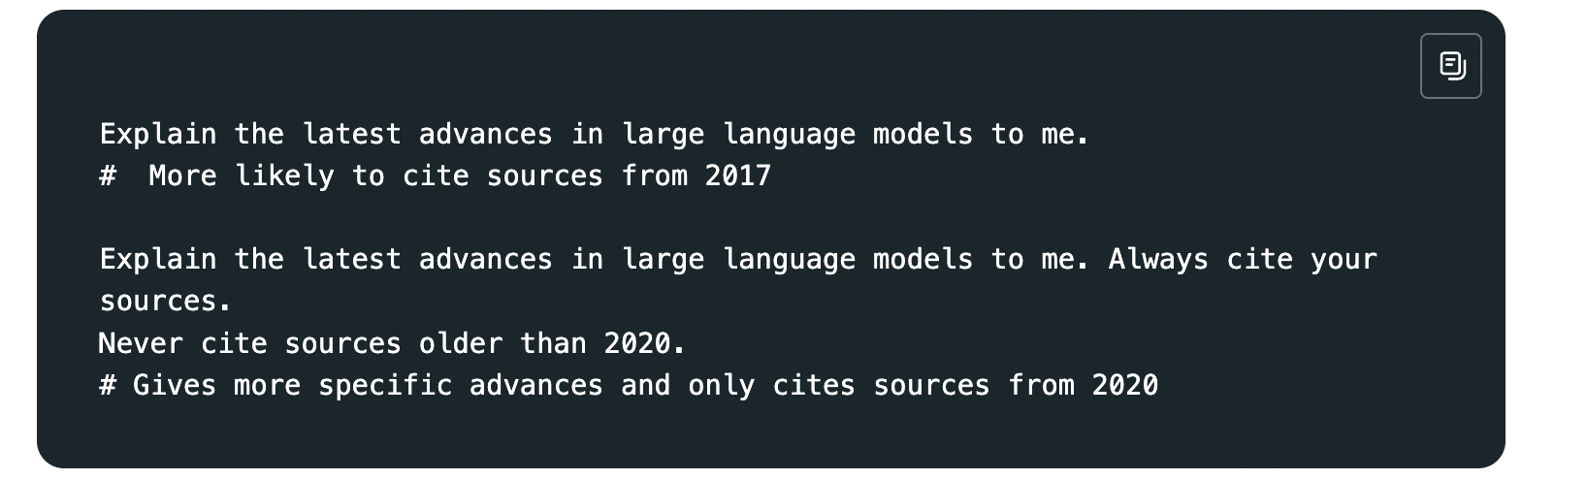
Explicit Instructions
More specific results on recently created resources

Slide 34
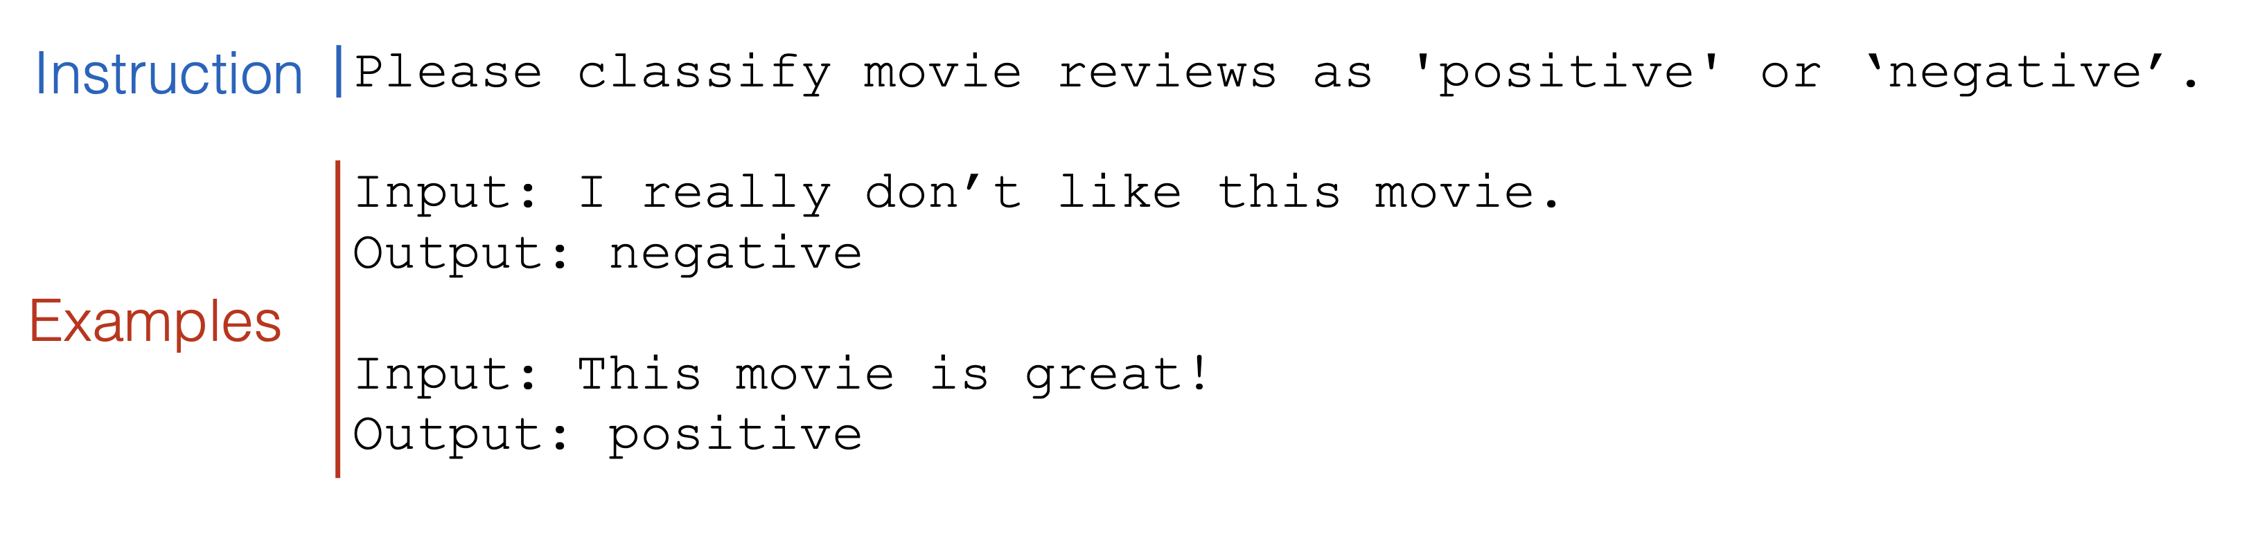
In-context Learning/Few-shot Prompting (Brown+ 2021)
Provide a few labeled examples of the downstream task in the instruction
Zero-shot
One-shot
Few-shot

Slide 35
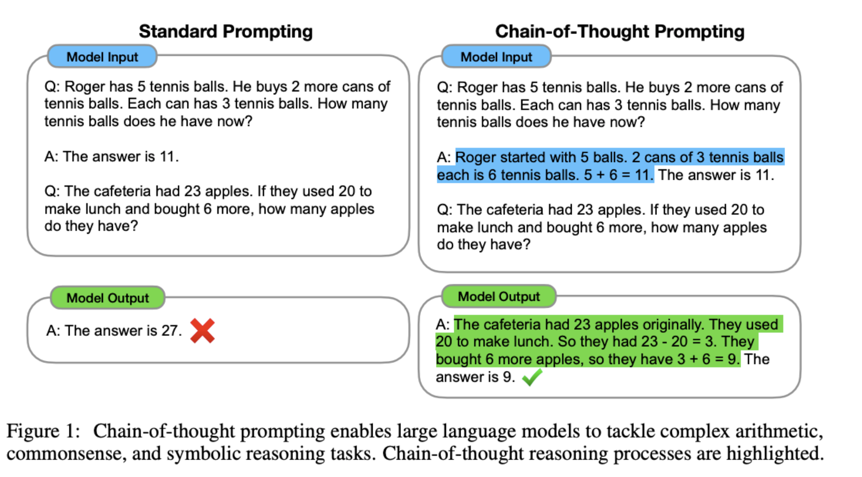
Chain of Thought Prompting (Wei et al. 2022)
Push the model to explain its reasoning before generating a response

Slide 36
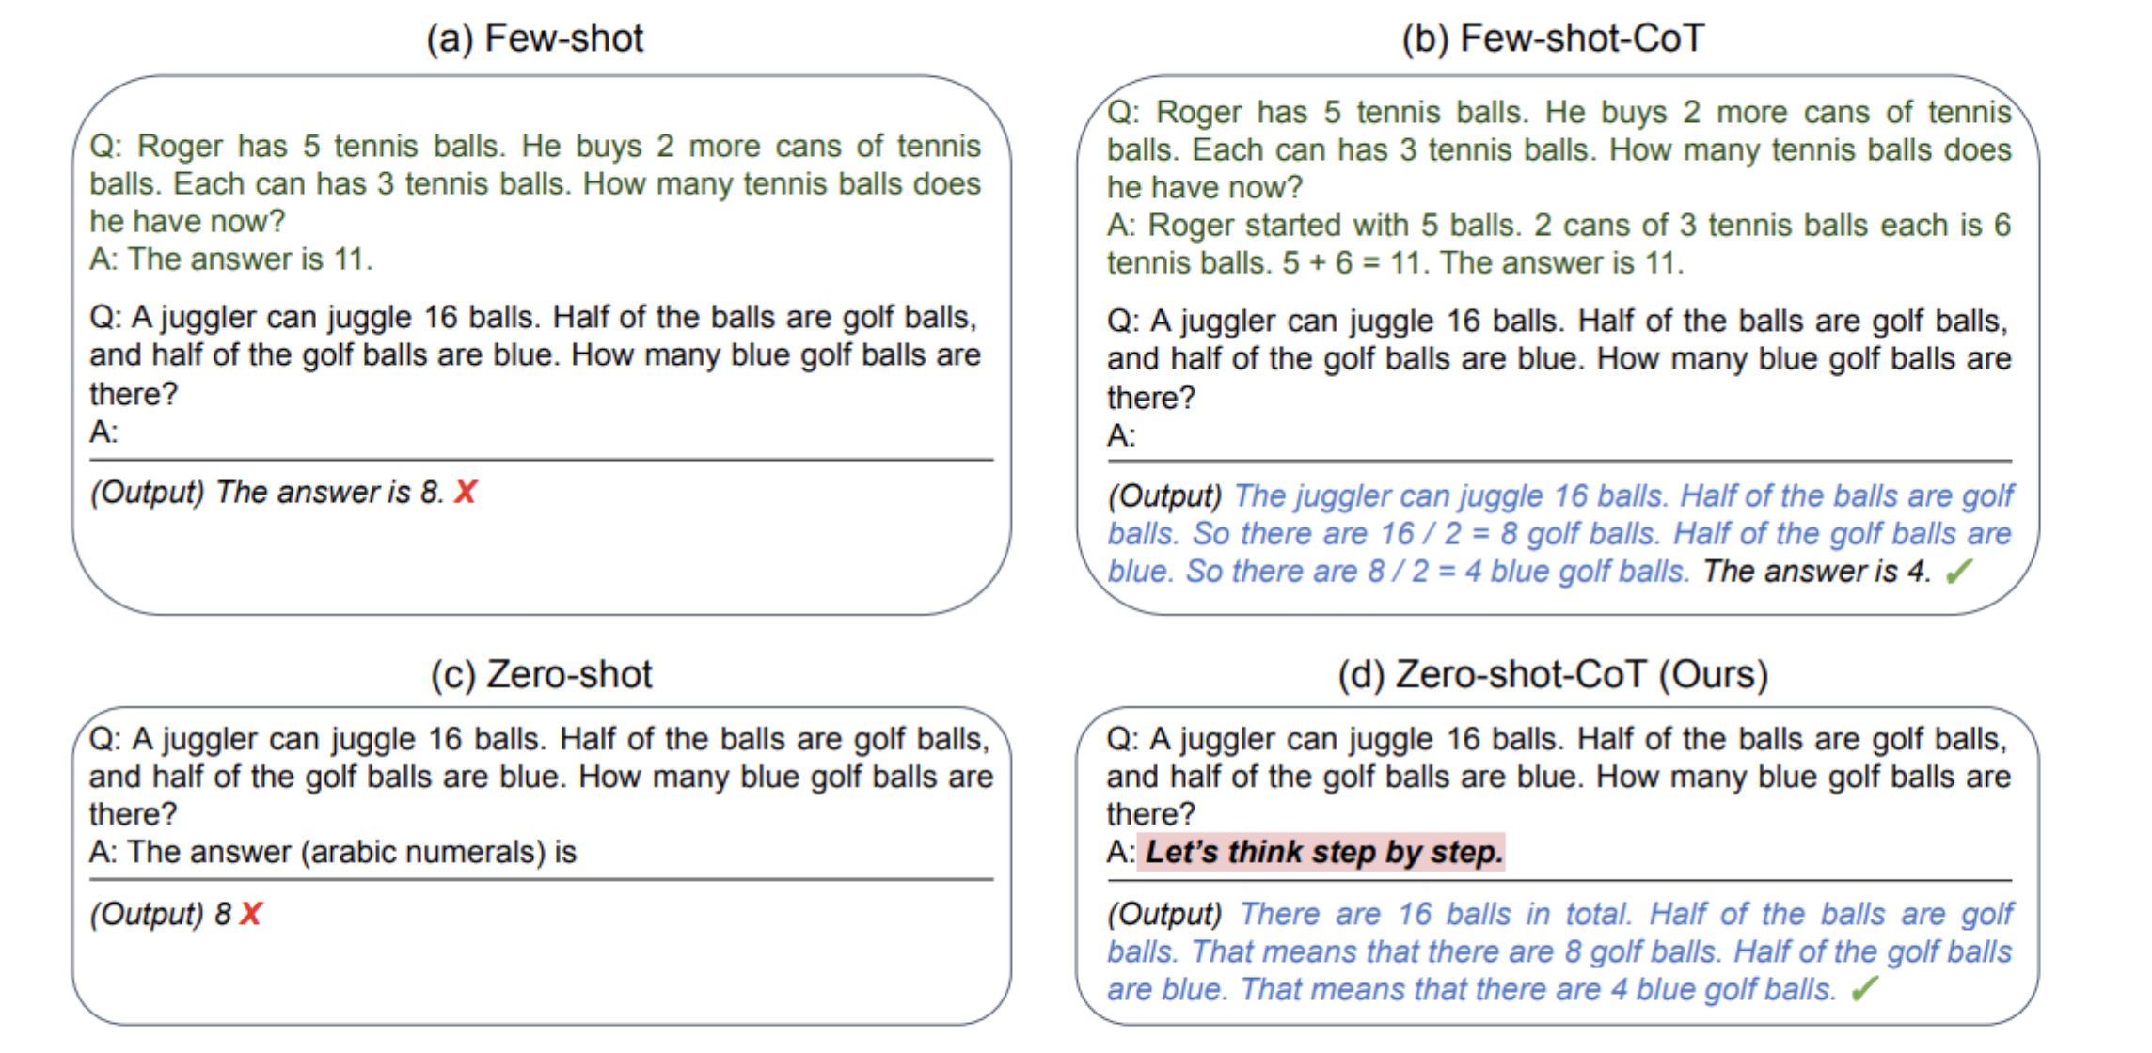
Unsupervised Chain-of-thought Prompting (Kojima et al. 2022)
Adding a prompt to encourage the model to generate explanations before generating the response

Slide 37
Guidelines of Crating Effective Prompts
Be clear and concise: easy to understand, provide enough information for the model to generate relevant output.
Use specific examples: Providing specific examples to help the model better understand expected output.
Vary the prompts: Try different prompts to produce more diverse and creative output..
Test and refine: Refine the prompts according to the outputs of the tested prompts
Use feedback: Use feedback from users or other sources to continually improve your prompts
https://www.llama.com/docs/how-to-guides/prompting

Slide 38
OpenAI o1
OpenAI o1: a new large language model trained with reinforcement learning to perform complex reasoning. o1 thinks before it answers—it can produce a long internal chain of thought before responding to the user.

Slide 39
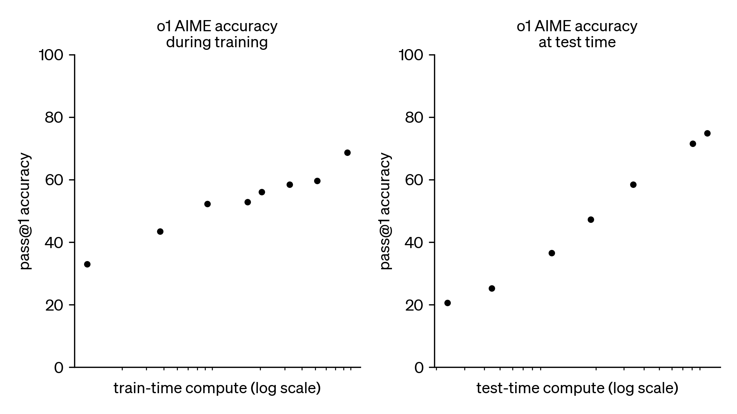
Performance w.r.t. train/test-time compute
o1 performance smoothly improves with both train-time and test-time compute

Slide 40
Prompt Engineering with Llama 3
https://github.com/amitsangani/Llama/blob/main/Llama_3_Prompt_Engineering.ipynb

Slide 41
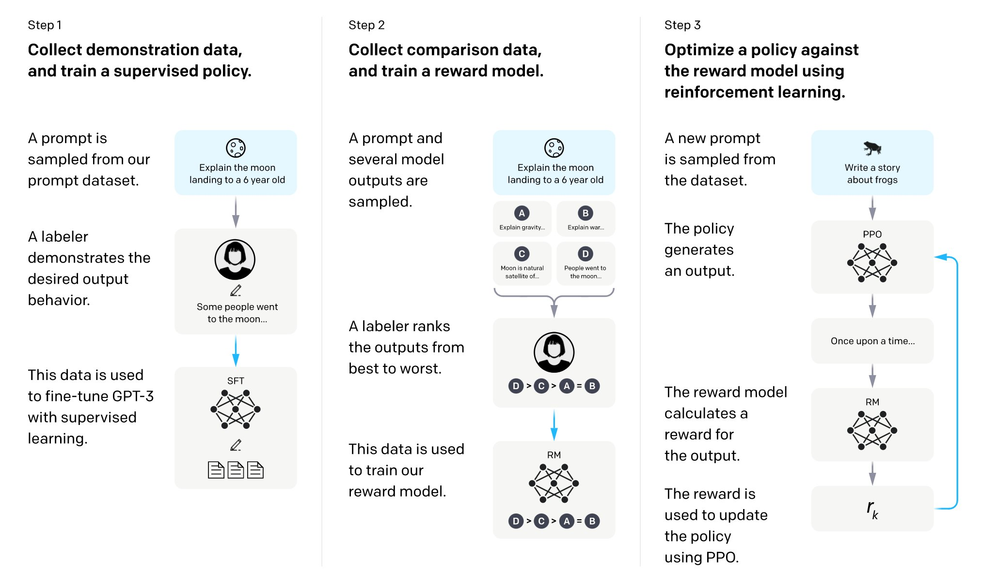
The overall training process of ChatGPT

Slide 42
Thanks!

